Slide 1
WORLD UNIVERSITY RANKINGS ANALYSIS

Slide 2
WELCOME!
Thank you for coming today!

Slide 3
WELCOME!
LE TRUONG KHANG
Notes:
No slide master

Slide 4

Please do not record this presentation.
Today’s contents should be kept secret because they are too useful :D

Slide 5






TIMELINE
ABOUT ME
DATASET INTRODUCTION
CLEAN DATA
ANALYSE
VISUALIZE
REFERENCES
About me.
What this dataset is about?
Python
SQL server
Power BI
www

Slide 6


ABOUT ME

Slide 7




HELLO,
LET ME INTRODUCE MYSELF…
IDEA
DESIGN
PRODUCE
My name is Khang.
…
Facebook facebook.com
Twitter twitter.com
E-mail
khangbop114@mail.com

Slide 8

DATASET INTRODUCTION

Slide 9
ABOUT THIS DATASET
Of all the universities in the world, which are the best?
Ranking universities is a difficult, political, and controversial practice. There are hundreds of different national and international university ranking systems, many of which disagree with each other. This dataset contains three global university rankings from very different places.
https://www.kaggle.com/datasets/mylesoneill/world-university-rankings?select=cwurData.csv

Slide 10

CLEAN DATA

Slide 11




IMPORT DATA
READ & CHECK DATATYPE
CLEAN DATA

Slide 12
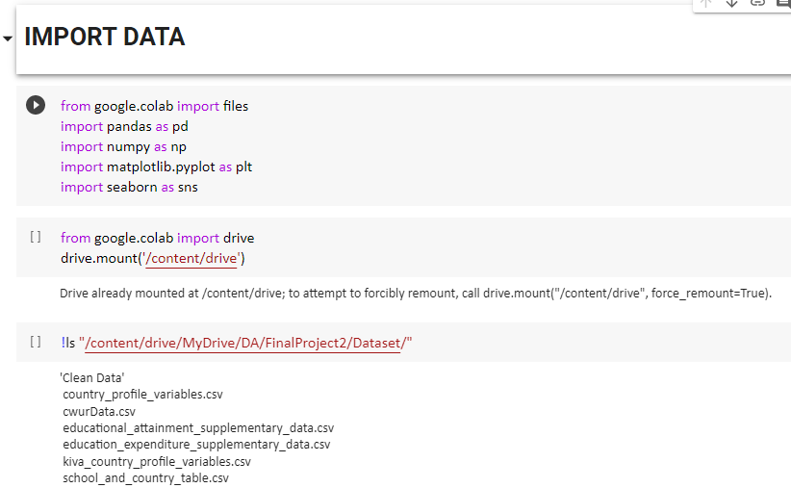
Python

Slide 13
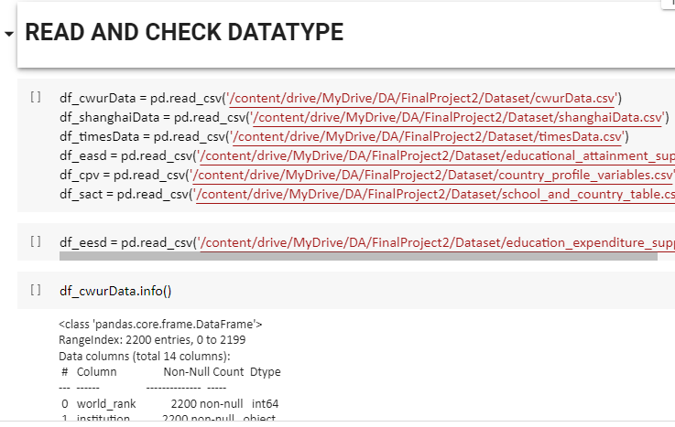
Python

Slide 14
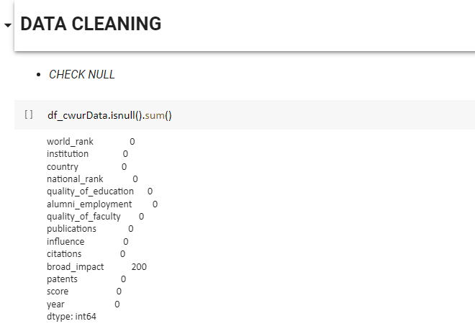
Python

Slide 15
GO FORWARD!

Slide 16

ANALYSE

Slide 17





MY SQL
SERVER
Center for World University Rankings
CWURData
Academic Rankings of World Universities
ShanghaiData
Times Higher Education World Ranking
TimesData
Education Expenditure
Supplement Data
UN Data
Supplement Data

Slide 18
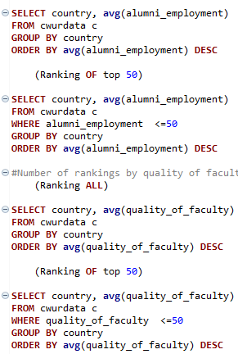
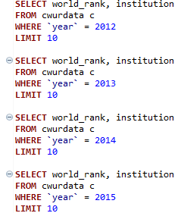
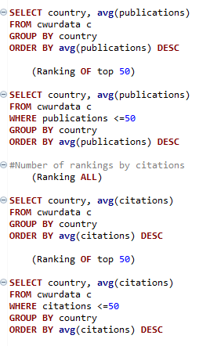
Center for World University Rankings
TOP 10 INSTITUTIONS
RANKINGS CATEGORY BY COUNTRY

Slide 19
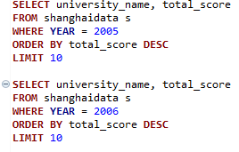
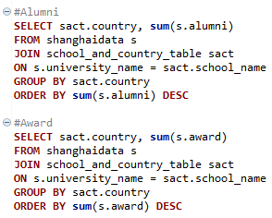
Academic Ranking of World Universites
BEST UNIVERSITY OVER THE YEAR
RANKINGS OF CATEGORY BY COUNTRY

Slide 20
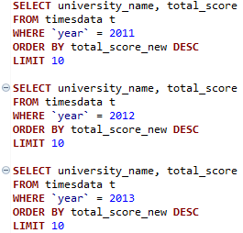
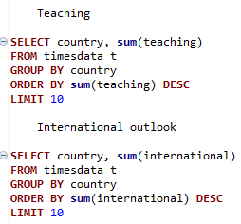
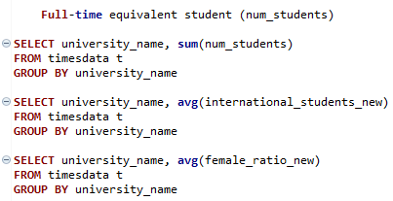
Times Higher Education World Ranking
TOP 10 UNIVERSITIES EACH YEAR
RANKINGS CATEGORY BY COUNTRY
RANKINGS ADDITIONAL METRIC

Slide 21
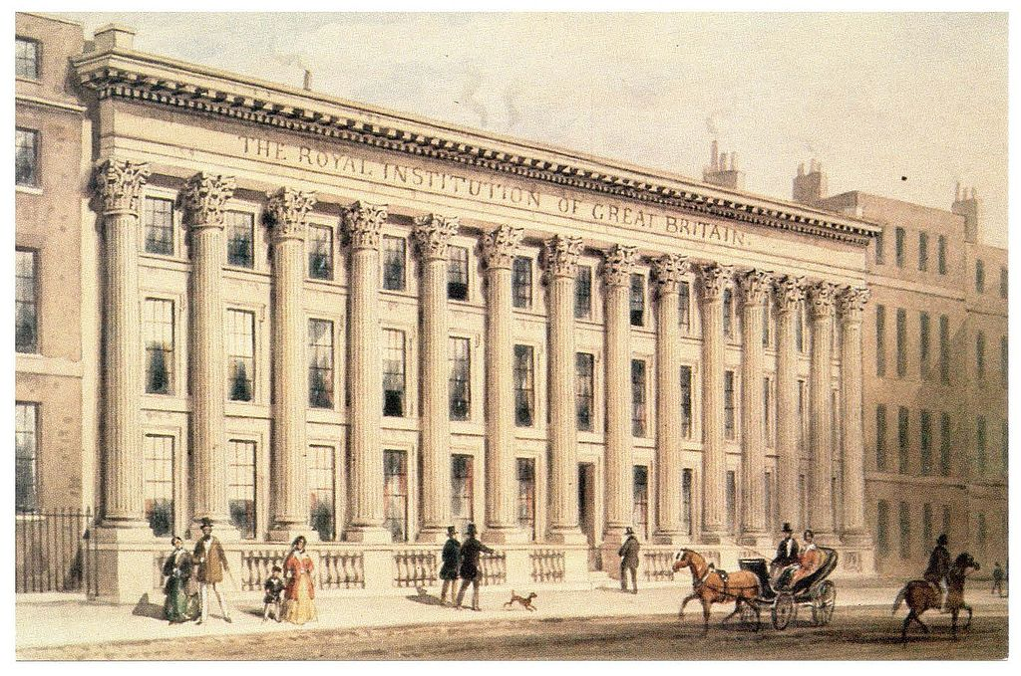
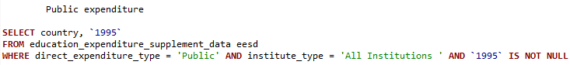

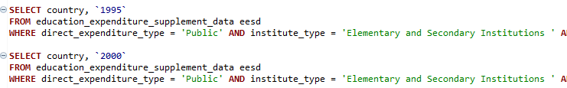

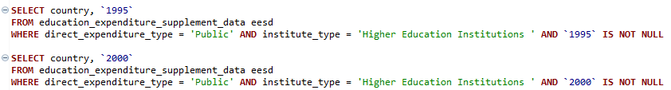
Education Expenditure
All Institutions
Elementary & Secondary Institutions
Higher Education Institutions

Slide 22
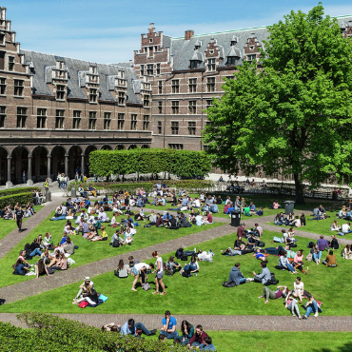
DON’T LOOK BACK

Slide 23

VISUALIZE

Slide 24
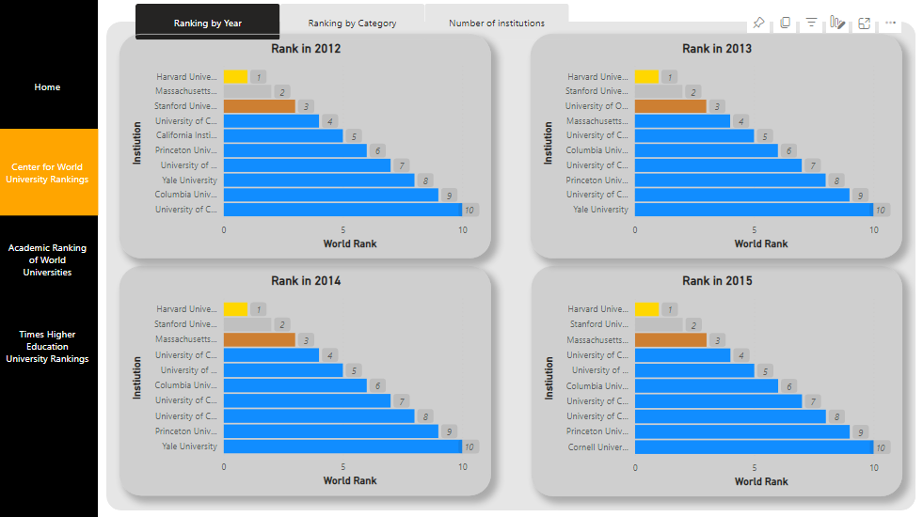

Slide 25
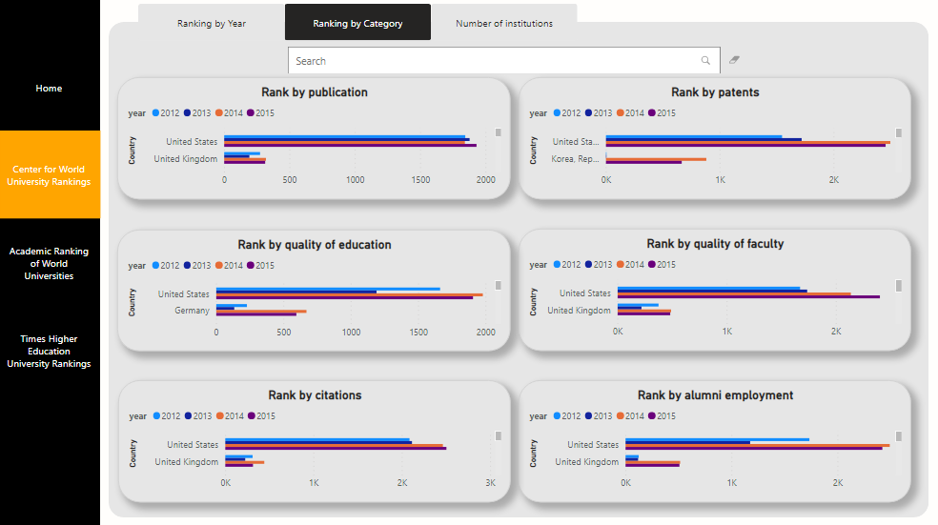

Slide 26
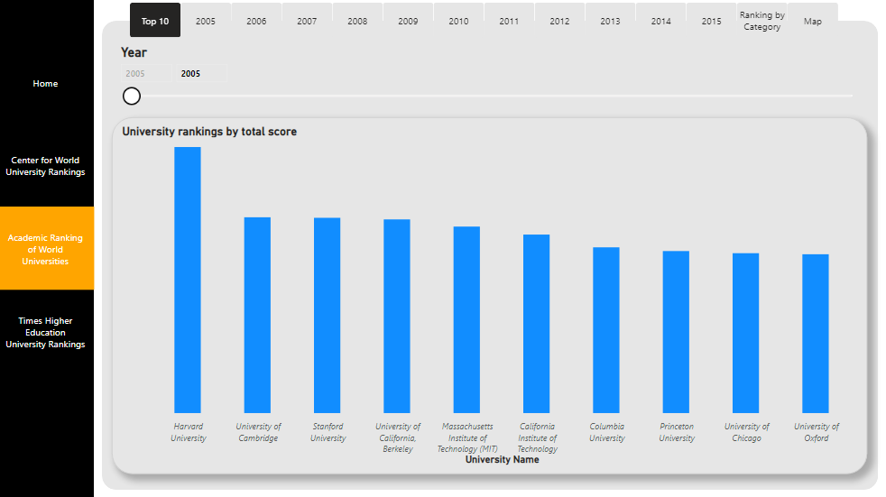

Slide 27
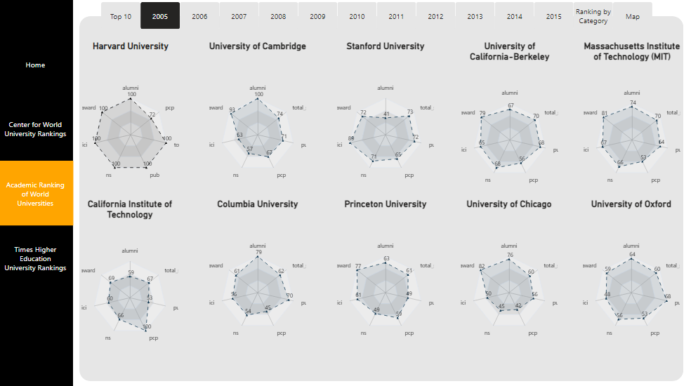

Slide 28
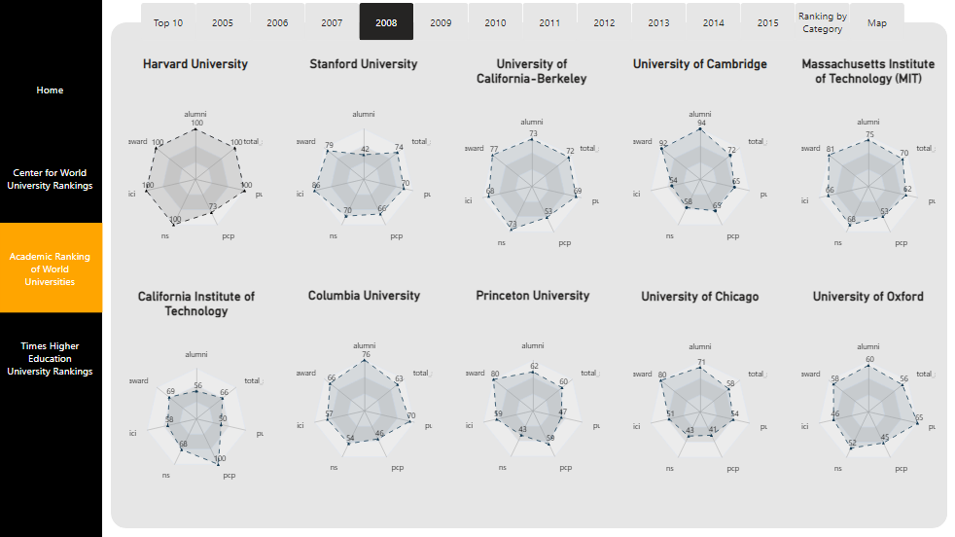

Slide 29
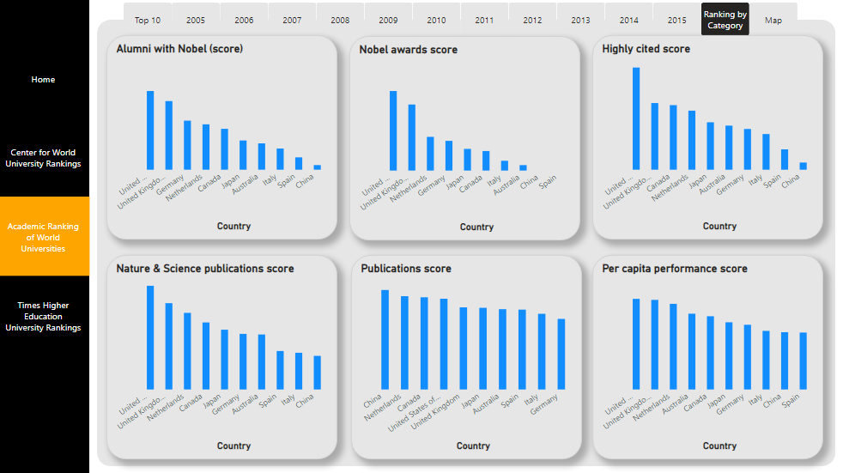

Slide 30
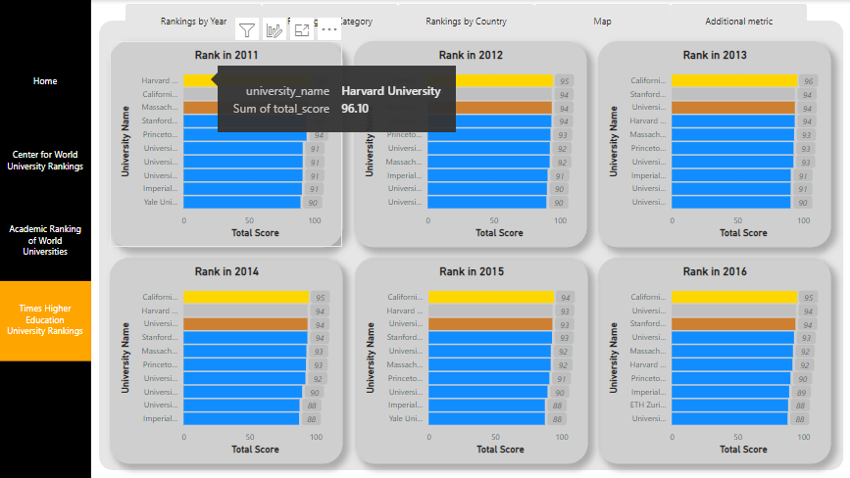

Slide 31
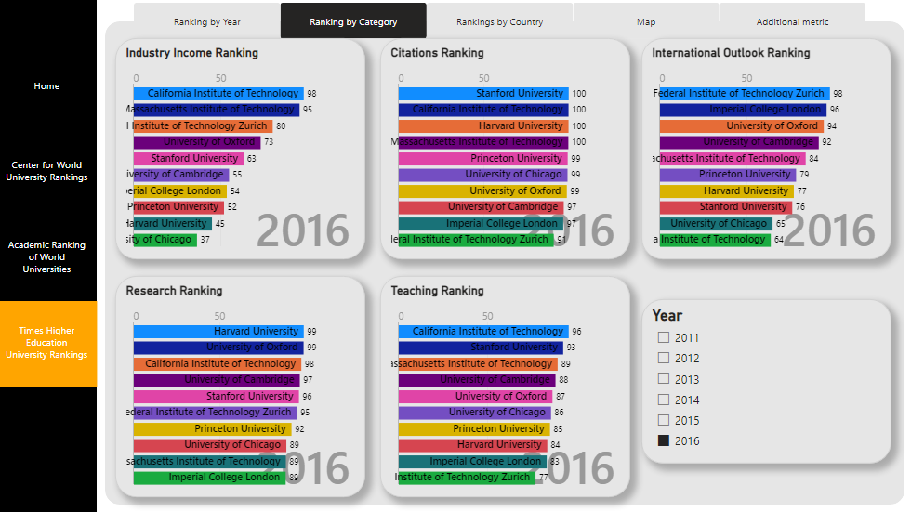

Slide 32
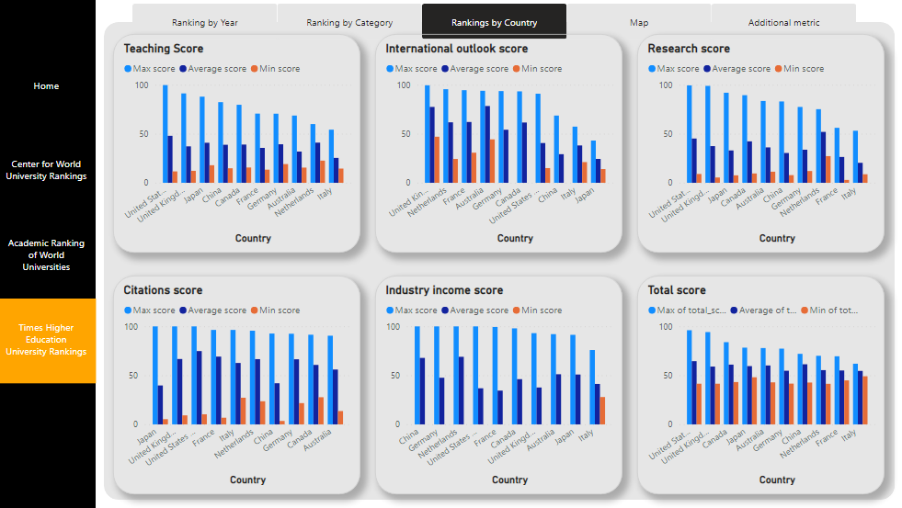

Slide 33
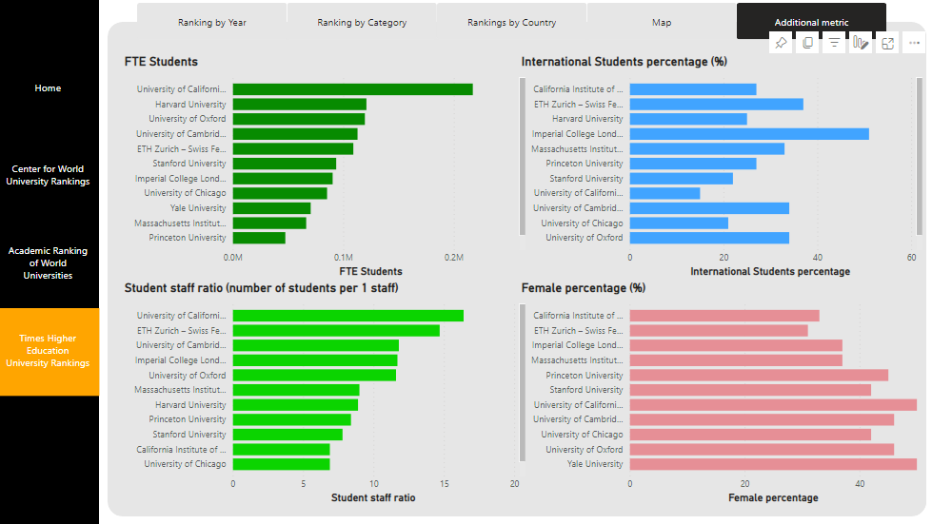

Slide 34

REFERENCES

Slide 35
REFERENCES
https://www.kaggle.com/datasets/mylesoneill/world-university-rankings?select=cwurData.csv
Main Data
https://www.timeshighereducation.com/world-university-rankings
http://www.shanghairanking.com/
https://cwur.org/
Supplement Data
https://nces.ed.gov/programs/digest/d14/tables/dt14_605.20.asp
https://www.kaggle.com/datasets/sudalairajkumar/undata-country-profiles

Slide 36
FLY HIGH, WHERE NOBODY CAN TOUCH YOU!

Slide 37
THANK YOU!
ANY QUESTIONS?
Jun Akizaki - http://thepopp.com
Used Font: Roboto Light & Roboto Condensed Light
Icon: Font generated by flaticon.com under CC BY. The authors are: Stephen Hutchings. Changed the color by Photoshop
World Map: http://www.tutsking.com/vectors/world-dots-map Changed the color by Photoshop

